Slide 1
Did That Happen So We Could Do This?
Luke 2:1-16 & Hebrews 4:12

Slide 2
Luke 2:1-16 (NLT)
¹ At that time the Roman emperor, Augustus, decreed that a census should be taken throughout the Roman Empire. ² (This was the first census taken when Quirinius was governor of Syria.)

Slide 3
Luke 2:1-16 (NLT)
³ All returned to their own ancestral towns to register for this census. ⁴ And because Joseph was a descendant of King David, he had to go to Bethlehem in Judea, David's ancient home. He traveled there from the village of Nazareth in Galilee.

Slide 4
Luke 2:1-16 (NLT)
⁵ He took with him Mary, to whom he was engaged, who was now expecting a child.
⁶ And while they were there, the time came for her baby to be born. ⁷ She gave birth to her firstborn son.

Slide 5
Luke 2:1-16 (NLT)
She wrapped him snugly in strips of cloth and laid him in a manger, because there was no lodging available for them. ⁸ That night there were shepherds staying in the fields nearby, guarding their flocks of sheep.

Slide 6
Luke 2:1-16 (NLT)
⁹ Suddenly, an angel of the Lord appeared among them, and the radiance of the Lord's glory surrounded them. They were terrified, ¹⁰ but the angel reassured them.

Slide 7
Luke 2:1-16 (NLT)
"Don't be afraid!" he said. "I bring you good news that will bring great joy to all people. ¹¹ The Savior—yes, the Messiah, the Lord—has been born today in Bethlehem, the city of David!

Slide 8
Luke 2:1-16 (NLT)
¹² And you will recognize him by this sign: You will find a baby wrapped snugly in strips of cloth, lying in a manger."
¹³ Suddenly, the angel was joined by a vast host of others—the armies of heaven—praising God and saying,

Slide 9
Luke 2:1-16 (NLT)
¹⁴ "Glory to God in highest heaven,
and peace on earth to those with whom God is pleased."
¹⁵ When the angels had returned to heaven, the shepherds said to each other, "Let's go to Bethlehem!

Slide 10
Luke 2:1-16 (NLT)
Let's see this thing that has happened, which the Lord has told us about."
¹⁶ They hurried to the village and found Mary and Joseph. And there was the baby, lying in the manger.

Slide 11
Hebrews 4:12 (NKJV)
For the word of God is living and powerful, and sharper than any two-edged sword, piercing even to the division of soul and spirit, and of joints and marrow, and is a discerner of the thoughts and intents of the heart.

Slide 12
Four Points:
God is a Jealous God, Jesus is a Jealous Lord
Christmas; Rooted in Faith or Rooted in Idolatry?
“But I’m Not Doing This for That”
Jesus Said “Do This In Remembrance of Me”

Slide 13
Point #1: God is a Jealous God, Jesus is a Jealous Lord
Exodus 34:14 (KJV)
I Corinthians 10:15-22 (AMP)
Colossians 3:5 (KJV)(CEV)

Slide 14
Exodus 34:14 (KJV)
For thou shalt worship no other god: for the LORD, whose name is Jealous, is a jealous God:

Slide 15
I Corinthians 10:15-22 (AMP)
15 I am speaking as to intelligent (sensible) men. Think over and make up your minds [for yourselves] about what I say. [I appeal to your reason and your discernment in these matters.]

Slide 16
I Corinthians 10:15-22 (AMP)
16 The cup of blessing [of wine at the Lord’s Supper] upon which we ask [God’s] blessing, does it not mean [that in drinking it] we participate in and share a fellowship (a communion) in the blood of Christ (the Messiah)?

Slide 17
I Corinthians 10:15-22 (AMP)
The bread which we break, does it not mean [that in eating it] we participate in and share a fellowship (a communion) in the body of Christ?

Slide 18
I Corinthians 10:15-22 (AMP)
17 For we [no matter how] numerous we are, are one body, because we all partake of the one Bread [the One Whom the communion bread represents].

Slide 19
I Corinthians 10:15-22 (AMP)
18 Consider those [physically] people of Israel. Are not those who eat the sacrifices partners of the altar [united in their worship of the same God]?

Slide 20
I Corinthians 10:15-22 (AMP)
19 What do I imply then? That food offered to idols is [intrinsically changed by the fact and amounts to] anything or that an idol itself is a [living] thing?

Slide 21
I Corinthians 10:15-22 (AMP)
20 No, I am suggesting that what the pagans sacrifice they offer [in effect] to demons (to evil spiritual powers) and not to God [at all]. I do not want you to fellowship and be partners with diabolical spirits [by eating at their feasts].

Slide 22
I Corinthians 10:15-22 (AMP)
21 You cannot drink the Lord’s cup and the demons’ cup. You cannot partake of the Lord’s table and the demons’ table. 22 Shall we thus provoke the Lord to jealousy and anger and indignation? Are we stronger than He [that we should defy Him]?

Slide 23
Colossians 3:5 (KJV)
Mortify therefore your members which are upon the earth; fornication, uncleanness, inordinate affection, evil concupiscence, and covetousness, which is idolatry:

Slide 24
Colossians 3:5 (CEV)
Don't be controlled by your body. Kill every desire for the wrong kind of sex. Don't be immoral or indecent or have evil thoughts. Don't be greedy, which is the same as worshiping idols.

Slide 25
Point #2: Christmas; Rooted in Faith or rooted in Idolatry?
Acts 21:25 (KJV)
Root of the Celebration
Root of December 25th
Root of Christmas Caroling
Root of the Christmas Tree
Root of Giving of Gifts

Slide 26
Acts 21:25 (KJV)
As touching the Gentiles which believe, we have written and concluded that they observe no such thing, save only that they keep themselves from things offered to idols…

Slide 27
Root of the Celebration:
The time of the year when the sun reaches its lowest elevation occurs on the day with the fewest number of daylight hours. This is called the winter solstice and is typically on DEC-21 in the Northern Hemisphere.

Slide 28
"Solstice" is derived from two Latin words: "sol" meaning sun, and "sistere," to cause to stand still. Celebrations were often timed for about the 25th. Roman pagans first introduced the holiday of Saturnalia, a week long period of lawlessness celebrated between December 17-25.

Slide 29

During this period, Roman courts were closed, and Roman law dictated that no one could be punished for damaging property or injuring people during the weeklong celebration. The festival began when Roman authorities chose “an enemy of the Roman to represent the “Lord of Misrule.”

Slide 30
Each Roman community selected a victim whom they forced to indulge in food and other physical pleasures throughout the week. At the festival’s conclusion, December 25th, Roman authorities believed they were de-stroying the forces of darkness by bru-tally murdering this innocent person

Slide 31
Root of December 25th:
By the beginning of the 4th century, there was intense interest in choosing a day to celebrate Jesus’ birthday. Church leaders selected DEC-25 because this was the date recognized throughout the Roman Empire as the birthday of various Pagan gods.

Slide 32
In the 4th century CE, Christianity imported the Saturnalia festival hoping to take the pagan masses in with it. Christian leaders succeeded in converting to Christianity large numbers of pagans by promising them that they could continue to celebrate the Saturnalia as Christians.

Slide 33
The problem was that there was nothing intrinsically Christian about Saturnalia. To remedy this, these Christian leaders named Saturnalia’s concluding day, December 25th, to be Jesus’ birthday.

Slide 34
Root of Christmas Caroling:
The ancient Greek writer poet and historian Lucian (in his dialogue entitled Saturnalia) describes the festival’s observance in his time.

Slide 35
In addition to human sacrifice, he mentions these customs: widespread intoxication; going from house to house while singing naked; rape and other sexual license; and consuming human-shaped biscuits.

Slide 36
Root of the Christmas Tree:
Just as early Christians recruited Roman pagans by associating Christmas with the Saturnalia, so too worshippers of the Asheira cult and its offshoots were recruited by the Church sanctioning “Christmas Trees”.

Slide 37
Pagans had long worshipped trees in the forest, or brought them into their homes and decorated them, and this observance was adopted and painted with a Christian veneer by the Church.

Slide 38
Jeremiah 10:2-4 (KJV)
2 Thus saith the LORD, Learn not the way of the heathen, and be not dismayed at the signs of heaven; for the heathen are dismayed at them.

Slide 39
Jeremiah 10:2-4 (KJV)
3 For the customs of the people are vain: for one cutteth a tree out of the forest, the work of the hands of the workman, with the axe. 4 They deck it with silver and with gold; they fasten it with nails and with hammers, that it move not.

Slide 40
Root of Giving of Gifts:
In pre-Christian Rome, the emperors compelled their most despised citizens to bring offerings and gifts during the Saturnalia (in December) and Kalends (in January). Later, this ritual expanded to include gift-giving among the general populace.

Slide 41
The Catholic Church gave this custom a Christian flavor by re-rooting it in the supposed gift-giving of Saint Nicholas.

Slide 42
Point #3: “But I’m Not Doing This for That”
I Corinthians 6:9-10 (KJV)
I Kings 13:18-22 (KJV)

Slide 43
I Corinthians 6:9-10 (KJV)
9 Know ye not that the unrighteous shall not inherit the kingdom of God? Be not deceived: neither fornicators, nor idolaters, nor adulterers, nor effeminate, nor abusers of themselves with mankind,

Slide 44
I Corinthians 6:9-10 (KJV)
10 Nor thieves, nor covetous, nor drunkards, nor revilers, nor extortioners, shall inherit the kingdom of God.

Slide 45
I Kings 13:18-22 (KJV)
18 He said unto him, I am a prophet also as thou art; and an angel spake unto me by the word of the LORD, saying, Bring him back with thee into thine house, that he may eat bread and drink water. But he lied unto him.

Slide 46
I Kings 13:18-22 (KJV)
19 So he went back with him, and did eat bread in his house, and drank water.
20 And it came to pass, as they sat at the table, that the word of the LORD came unto the prophet that brought him back:

Slide 47
I Kings 13:18-22 (KJV)
21 And he cried unto the man of God that came from Judah, saying, Thus saith the LORD, Forasmuch as thou hast disobeyed the mouth of the LORD, and hast not kept the commandment which the LORD thy God commanded thee,

Slide 48
I Kings 13:18-22 (KJV)
22 But camest back, and hast eaten bread and drunk water in the place, of the which the LORD did say to thee, Eat no bread, and drink no water; thy carcase shall not come unto the sepulchre of thy fathers.

Slide 49
Logical conclusion:
The act of a sin is still a sin regardless of intention
The act of Idolatry is a sin
The unintentional practice
of idolatry is also sin

Slide 50
Point #4: Jesus Said, “Do This In Remembrance of Me”
I Corinthians 11:26 (NLT)
Ephesians 5:11 (KJV)
Hebrews 4:12 (NIV)

Slide 51
I Corinthians 11:26 (NLT)
For every time you eat this bread and drink this cup, you are announcing the Lord’s death until he comes again.

Slide 52
Ephesians 5:11 (KJV)
And have no fellowship with the unfruitful works of darkness, but rather reprove them.

Slide 53
Hebrews 4:12 (NIV)
For the word of God is alive and active. Sharper than any double-edged sword, it penetrates even to dividing soul and spirit, joints and marrow; it judges the thoughts and attitudes of the heart.

Slide 54

…that Christ died for our sins according to the scriptures;
And that he was buried, and that he rose again the third day according to the scriptures:

Slide 55
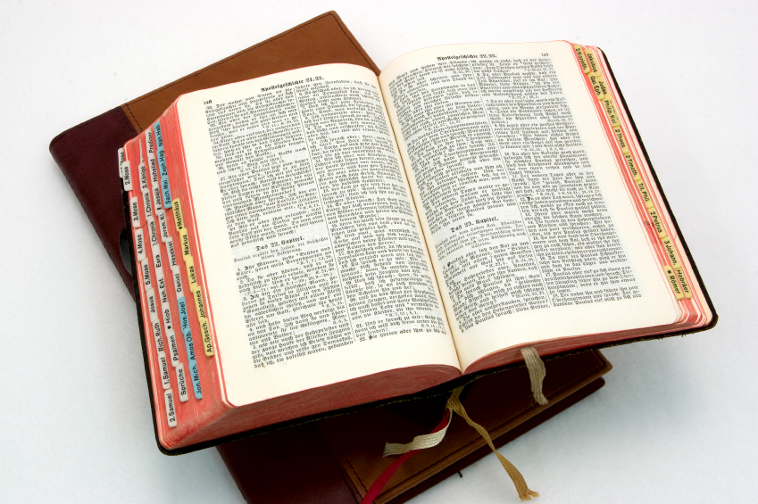
Hear: Romans 10:17
So then faith cometh by hearing, and hearing by the word of God.

Slide 56
Believe: Hebrews 11:6
But without faith it is impossible to please him: for he that cometh to God must believe that he is, and that he is a rewarder of them that diligently seek him.

Slide 57
Repent: Luke 13:3
I tell you, Nay: but, except ye repent, ye shall all likewise perish.

Slide 58
Confess: Matthew 10:32-33
32 Whosoever therefore shall confess me before men, him will I confess also before my Father which is in heaven.
33 But whosoever shall deny me before men, him will I also deny before my Father which is in heaven.

Slide 59
Baptize: Acts 22:16
And now why tarriest thou? arise, and be baptized, and wash away thy sins, calling on the name of the Lord.

